Slide 1

AI-Driven Agentic Healthcare Assistance and Intelligent Referral Management Platform
SOA Project Review-2
25-09-26
 | Under the Guidance of Dr. NEELIMA GOGINENI ASSOCIATE Professor, Department of Computer Science and Engineering, KLH CSE Bowrampet Campus
Team Members Name :S.LAKSHMI ABHISHIKTHA Roll Number: 2420030792

Slide 2
Outline of Project Work
Focus
Introduction
Literature Survey
Challenges
Research Objectives
Conclusion & Future Work
References
Publications Details

Slide 3
Problem Statement
Traditional healthcare systems often depend on manual and disconnected processes for patient assistance, healthcare provider selection, appointment management, and referral coordination. This can result in delayed responses, inefficient healthcare service coordination, difficulty identifying suitable healthcare providers, and limited personalized assistance. Therefore, there is a need for an intelligent, automated, and scalable platform that can provide personalized healthcare assistance and efficiently manage the referral process

Slide 4
Objectives
Develop an Agentic AI healthcare assistant using Gemini and LangGraph to understand and process user healthcare queries.
Automate intelligent referral management by supporting context gathering, risk assessment, doctor search, referral decisions, and emergency escalation.
Build a scalable microservices architecture using Spring Boot 3, Spring Cloud, Netflix Eureka, and Spring Cloud Gateway.
Provide secure healthcare services using JWT authentication and role-based authorization.
Develop a responsive React.js interface for patients and healthcare providers to access healthcare assistance, appointments, referrals, and notifications.
Implement reliable data management using MongoDB with modular service-level data handling.
Enable automated deployment and testing using Docker, GitHub Actions, and Postman Agent Mode.

Slide 5
Existing System & Limitations
Existing healthcare systems often use separate and disconnected services for patient care, appointments, providers, and referrals.
Traditional systems provide limited intelligent and personalized assistance to patients.
Most healthcare chatbots mainly support basic query answering rather than multi-step task coordination.
Referral processes often lack intelligent provider matching, risk assessment, and automated decision-making.
There is a need for a scalable microservices-based platform integrated with Agentic AI to coordinate healthcare assistance and referral workflows.
The proposed system addresses this gap by combining Gemini, LangGraph, intelligent agents, and microservices for automated and personalized healthcare referral management.

Slide 6
Project Design – Overall Architecture
Agentic AI Workflow: Uses Gemini and LangGraph to coordinate multi-step healthcare tasks instead of simple chatbot responses.
Intelligent Referral Management: Supports risk assessment, doctor search, referral decisions, and emergency escalation through an AI-driven workflow.
Microservices Architecture: Uses Spring Boot 3, Spring Cloud, Netflix Eureka, and Spring Cloud Gateway for a modular and scalable healthcare platform.
Personalized Assistance: Processes user requirements and context to provide relevant healthcare guidance and provider recommendations.
Secure Healthcare Platform: Implements JWT authentication and role-based authorization for controlled access to healthcare services.
Modern & Automated Development: Uses React.js, Docker, GitHub Actions, GitHub Copilot, Lucidchart AI, Jira, and Postman Agent Mode to support development, design, testing, and deployment.

Slide 7
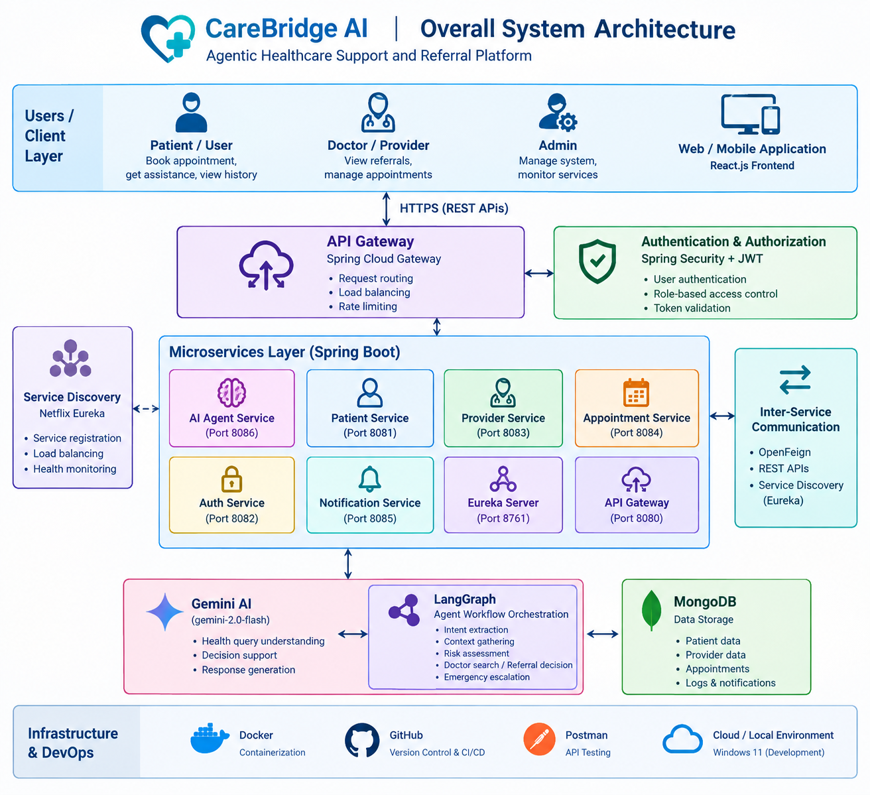

Slide 8
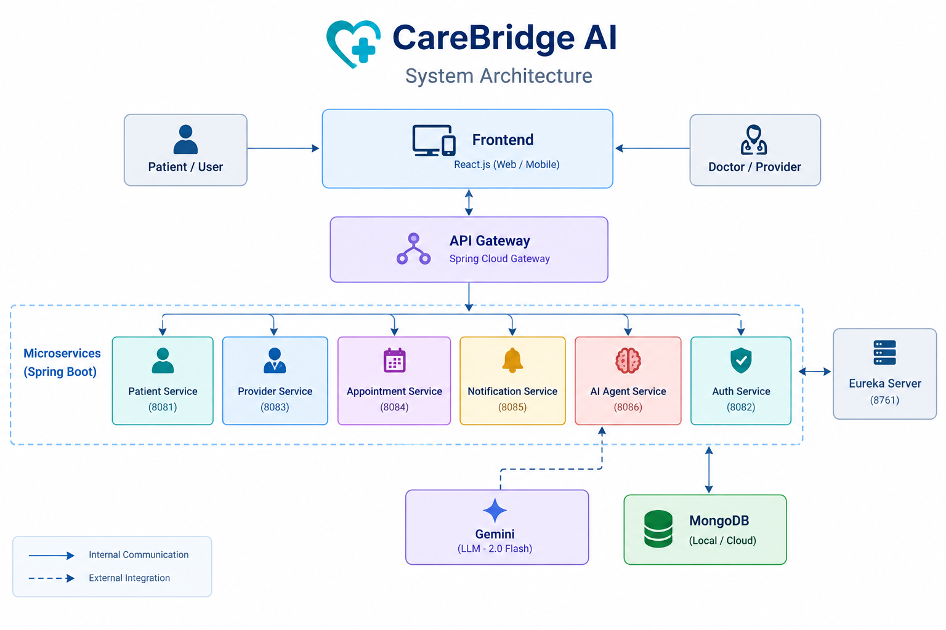

Slide 9
Feasibility and Project Plan
Technical Feasibility:
The project can be implemented using Spring Boot 3, Spring Cloud, React.js, MongoDB, Gemini, and LangGraph. Netflix Eureka, Spring Cloud Gateway, JWT, Docker, and GitHub Actions support service discovery, security, deployment, and automation.
Operational Feasibility:
The platform provides an accessible interface and automates healthcare assistance and referral workflows, reducing manual coordination and improving service management.

Slide 10
Methodology
CareBridge AI follows an agentic, modular, and service-oriented methodology to provide intelligent healthcare assistance and referral management.
Main steps:
User Interaction – Patient submits a healthcare query or request.
Intent Extraction – AI identifies the user's requirement.
Context Gathering – Relevant patient and healthcare information is collected.
Risk Assessment – The system evaluates the urgency/risk level.
Decision & Referral – The agent determines the appropriate next action.
Doctor Search – Suitable providers are identified based on the requirement.
Appointment / Referral – The user is guided toward the appropriate healthcare service.
Emergency Escalation – High-risk situations are escalated appropriately.

Slide 11
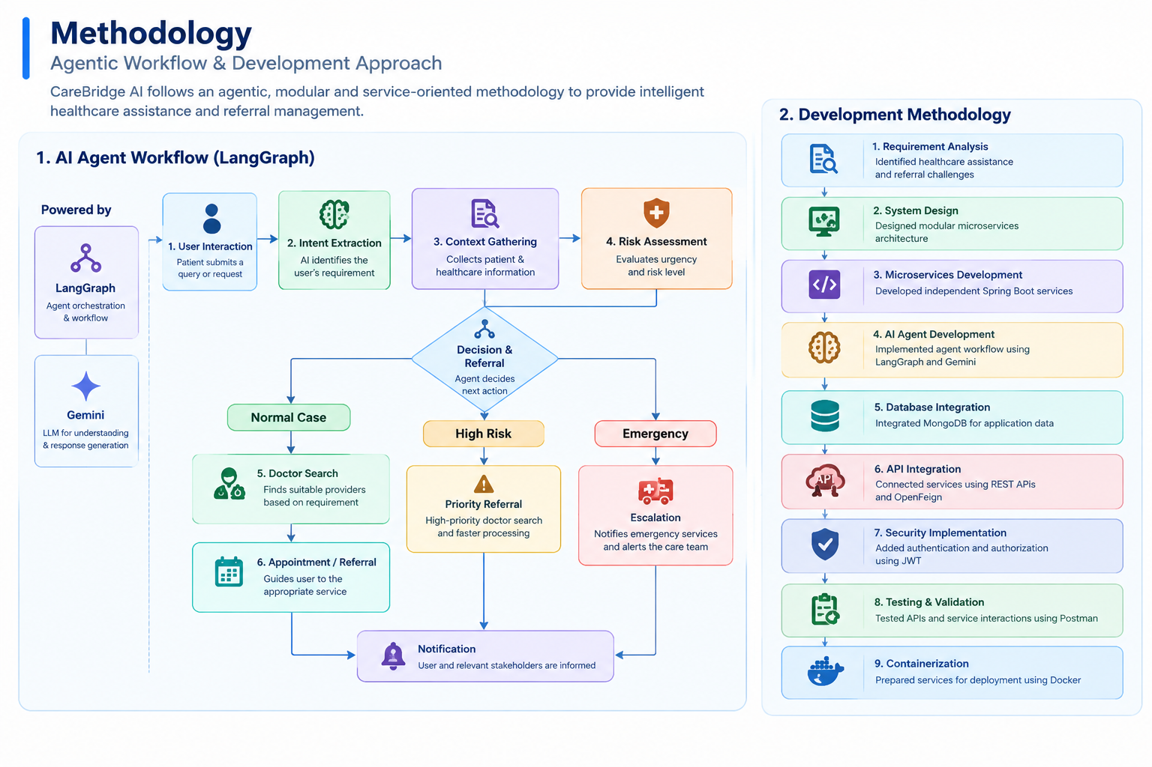

Slide 12
Technical Soundness
Architecture & Backend
Modular Spring Boot microservices architecture
Spring Cloud Gateway for API routing
Netflix Eureka for service discovery
OpenFeign & REST APIs for inter-service communication
AI & Data
LangGraph for agent workflow orchestration
Gemini 2.0 Flash for AI-based understanding and response generation
MongoDB for persistent storage of patient, provider and appointment data
Security & Reliability
Spring Security + JWT for authentication and authorization
Independent services provide modularity and scalability
API validation and service testing using Postman
Implementation & Deployment
React.js frontend integrated with backend services
Services configured for Docker containerization
Source code and documentation maintained in GitHub

Slide 13
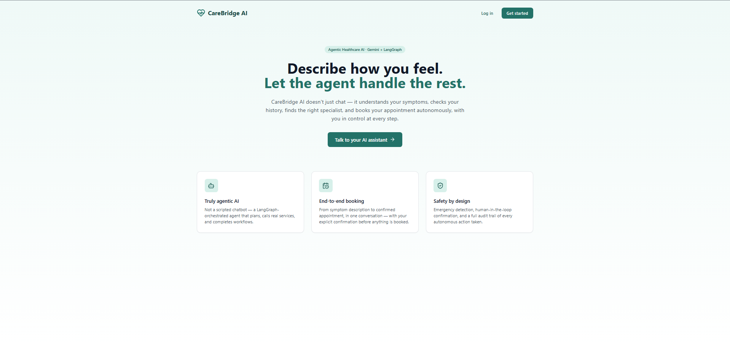
Authentication and Frontend implementation.

Slide 14
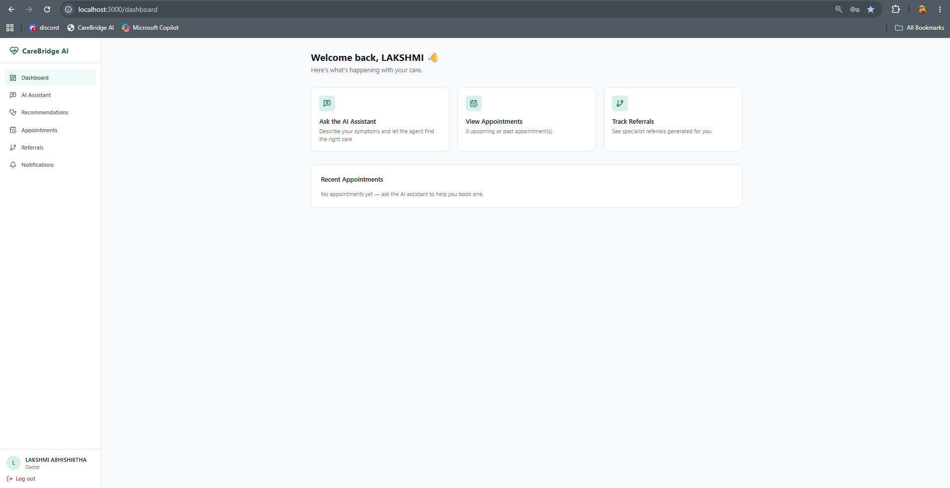
Frontend and System Functionality:Doctor Dashboard

Slide 15
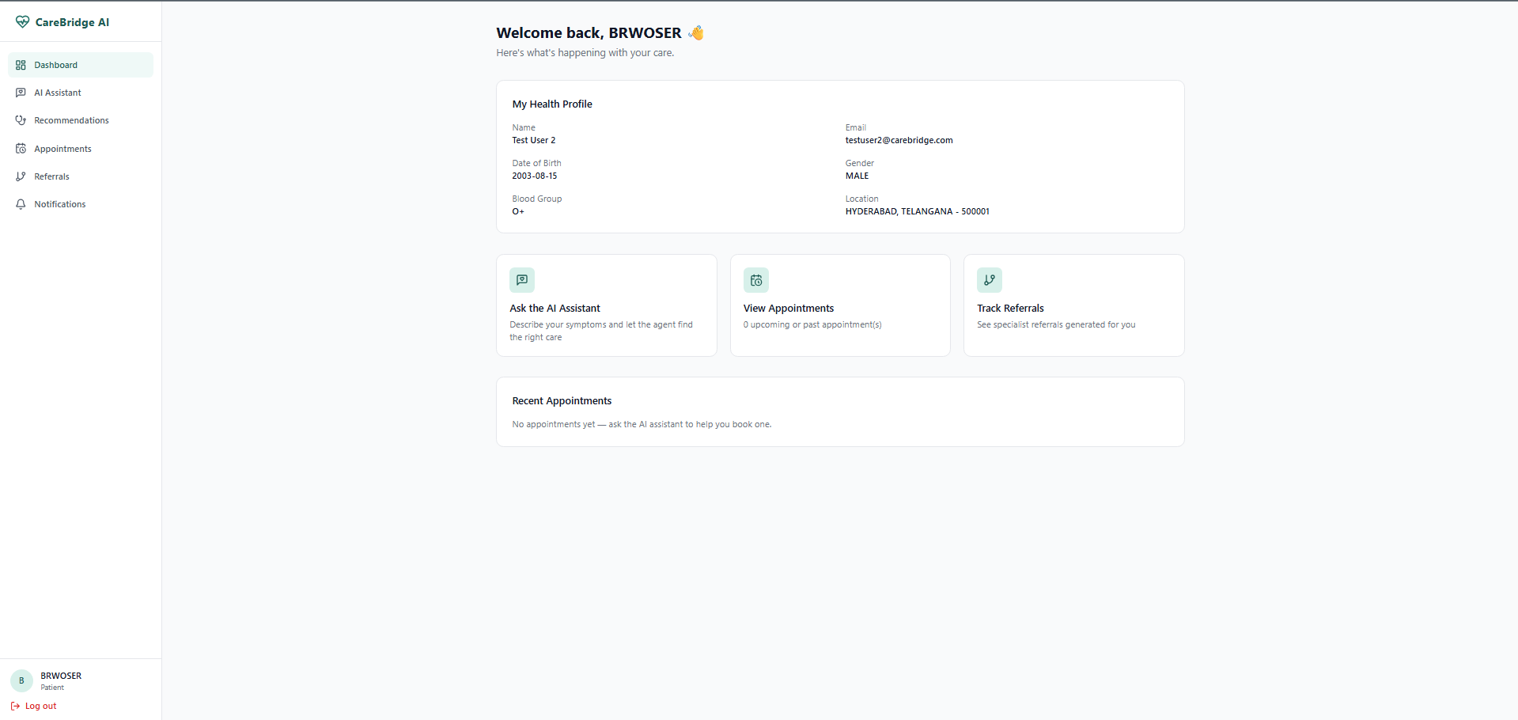
Patient Dashboard

Slide 16
THANK YOU
NAME:S.LAKSHMI ABHISHIKTHA
ROLL NO: 2420030792

